Slide 1


Slide 2



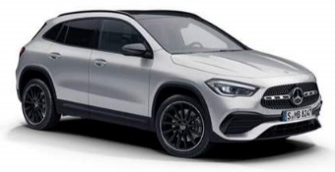
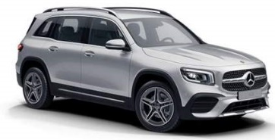






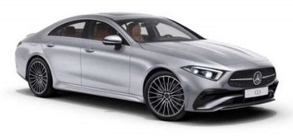




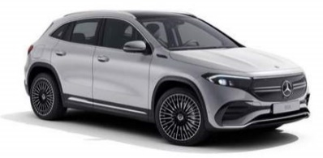
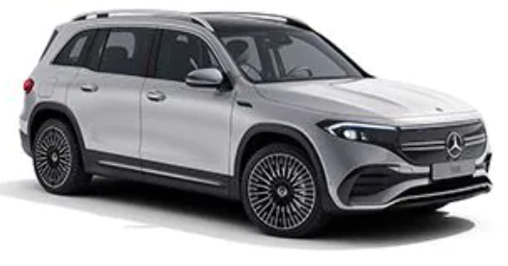
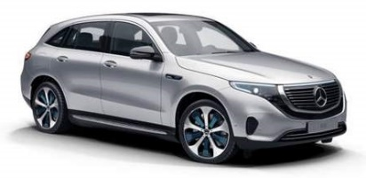
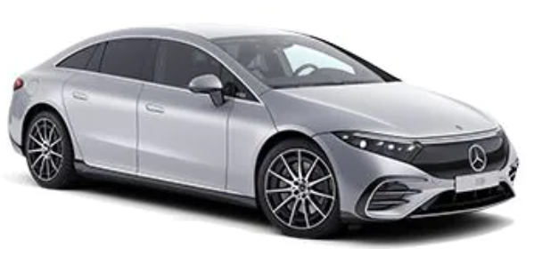

MFA
MHA
A-Class V/Z 177 | B-Class W 247 | CLA-Class C/X 118 | GLA-Class H 247 | GLB-Class X 247
GLE-Class V/C 167 | GLS-Class X 167
MRA
C-Class W/S/V 206 | C-Class A/C 205 | E-Class W/S/V 213 | E-Class A/C 238 | CLS-Class C 257 | AMG GT X 290
SUV
G-Class W 463
S-Class W/V/Z 223 | GLC-Class C/X 253
EQA H 243 | EQB X 243 | EQC N 293 | EQS V 297
MSA
AMG GT C/R 190
EVA
MFA | Mercedes Front-Wheel Architecture
MRA | Mercedes Rear-Wheel Architecture
MSA | Mercedes Sports Architecture
MHA | Mercedes High Architecture
SUV | Sport Utility Vehicle
EVA | Electric Vehicle Architecture
MMA | Mercedes Modular Architecture
Mercedes-Benz Cars (MBC) Product Portfolio
Body Style
W | Sedan / Hatchback / Sports Tourer | X | Special Version
V | Extended Sedan | S | Estate (Station Wagon)
A | Cabriolet (Convertible) | C | Coupé
H | City SUV (Crossover) | R | Roadster
 |  | Z | Special Version

Slide 3
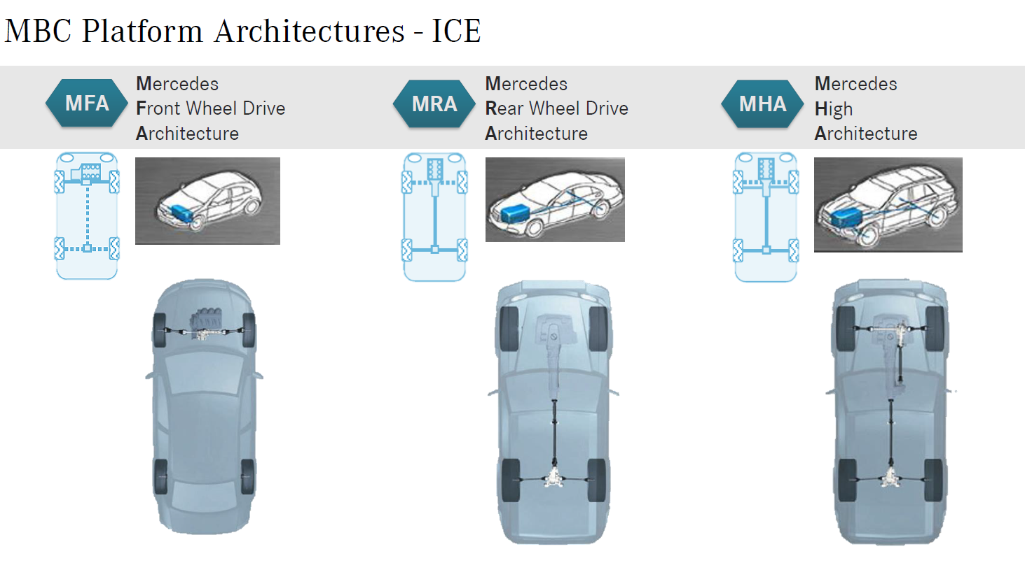

Slide 4
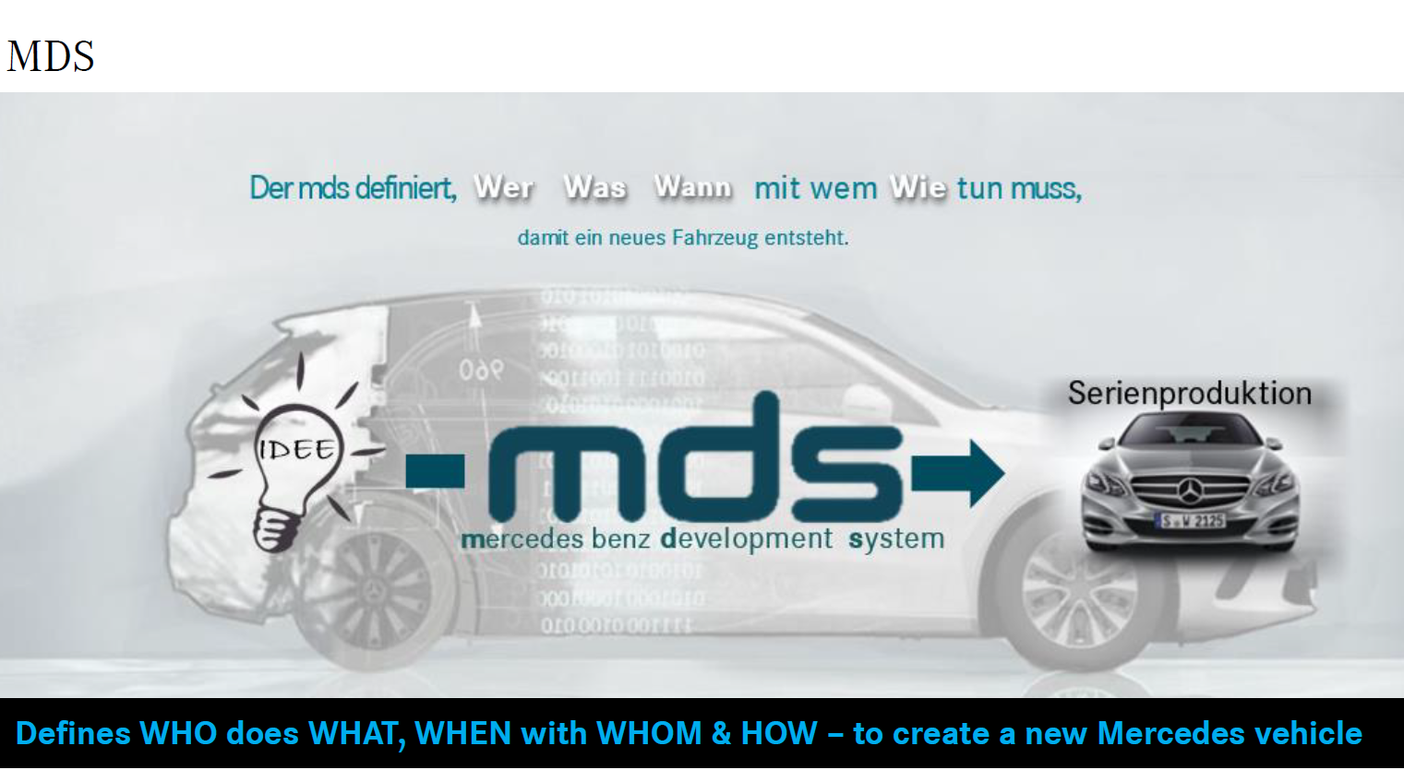

Slide 5
Vehicle Lifecycle – Phases of Development
DIGITAL Dev. Phase
SOP
NPP – LEAD/DERIVATE
H/W Dev. Phase
PRO
SERIES PRODUCTION
CY
CY
CY
MOPF
DIGITAL Dev. Phase
EOP
NPP: New Product Project
MOPF: Modellpflege (Facelift)
PRO: Production Tests
CY: Change Year (Änderungsjahr)
SOP/EOP: Start/End of Production
H/W Dev. Phase
PRO
SERIES PRODUCTION
CY
CY
CY

Slide 6
MDS
SOP
Strategy
Planning
Engineering
Commissioning
Pramissen
Smaragd
ITD / RD
EBOM
ITO / MO
Planning Backbone
Faplis Layout
Difa Product
Difa Planning
Difa Supplier Portal
MBOM
Equipment BOM
S1
S2
S3
Project Structure
Carline
Equipment Library
Difa Project
Difa Cost
Difa Library
Difa NG
DEEP

Slide 7
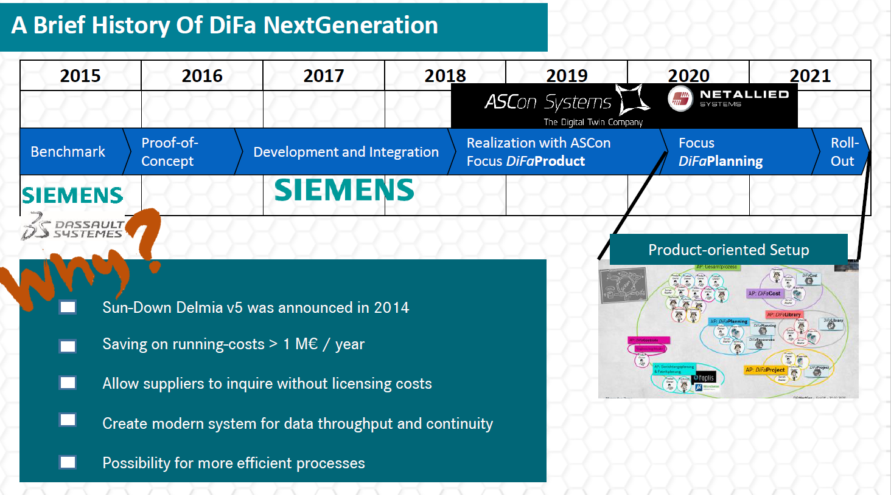

Slide 8
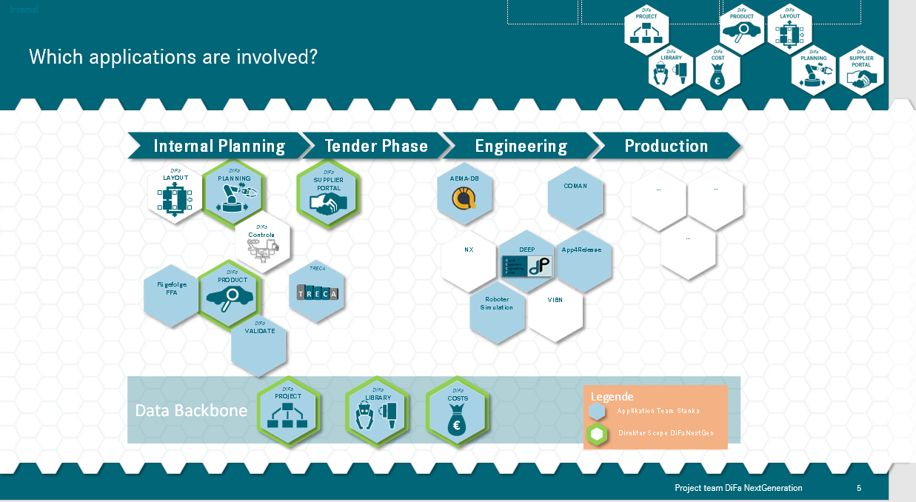

Slide 9
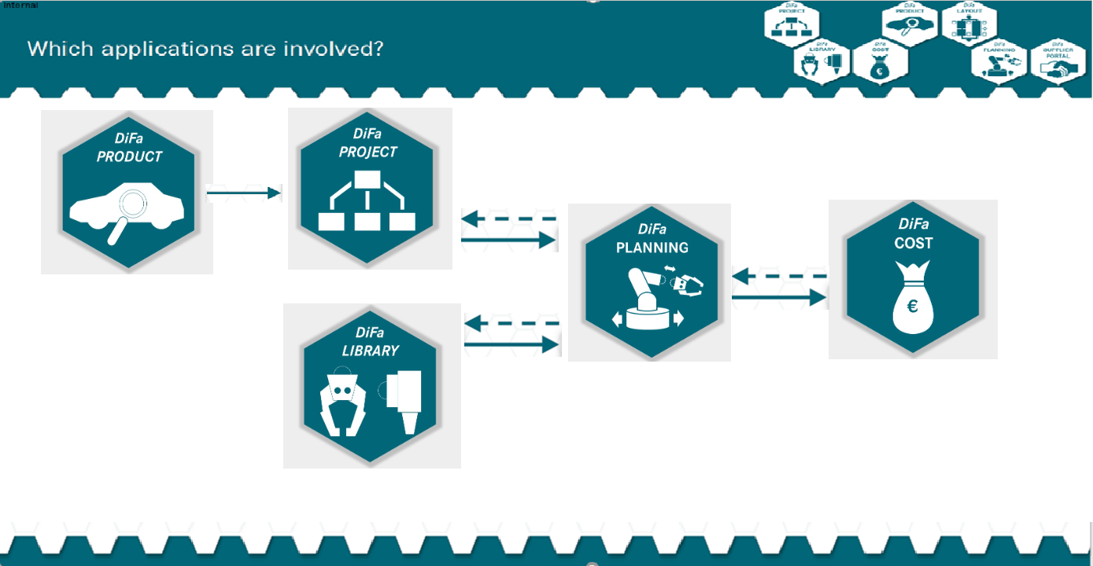

Slide 10
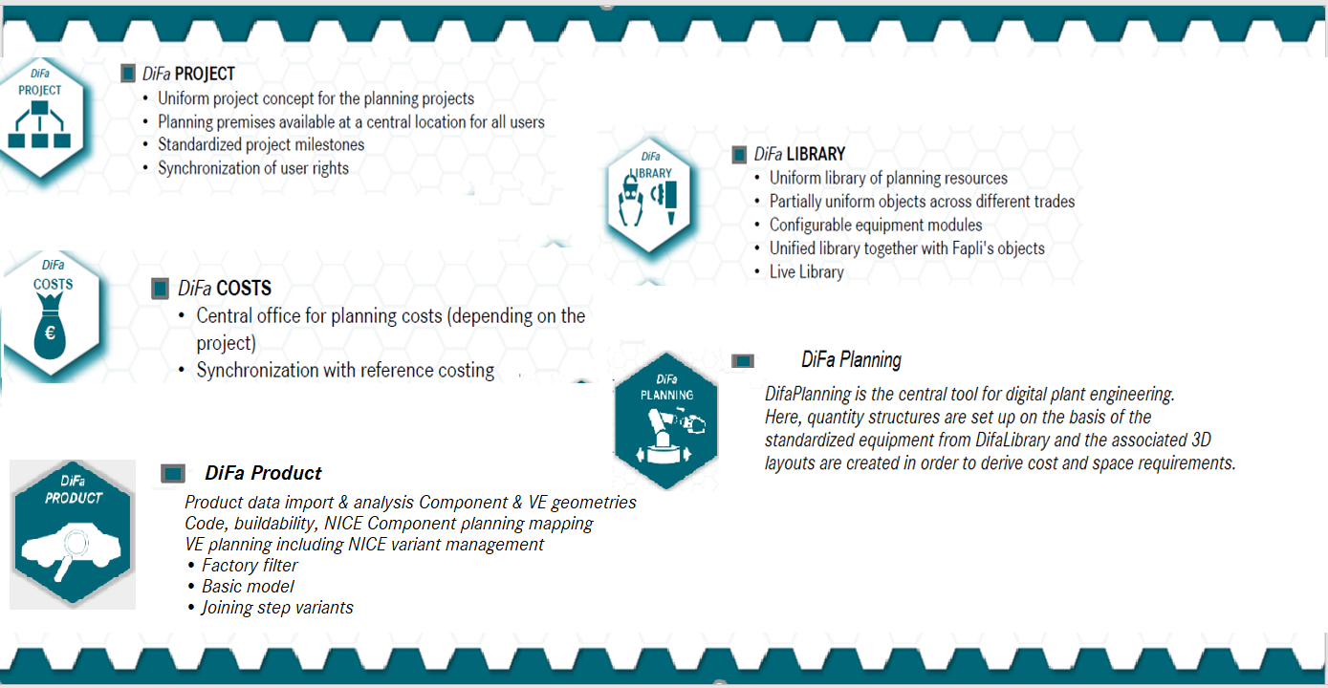

Slide 12
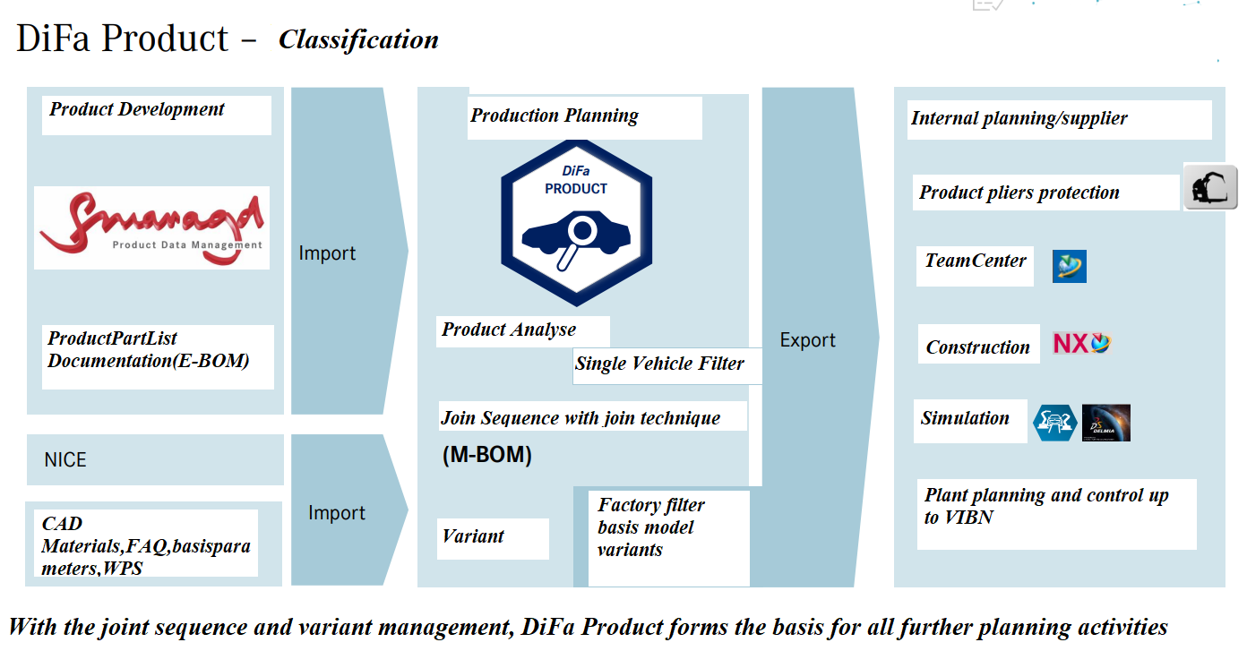

Slide 13
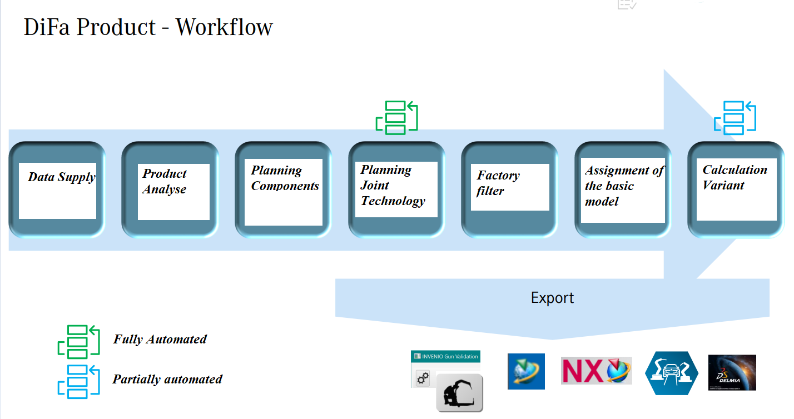

Slide 14
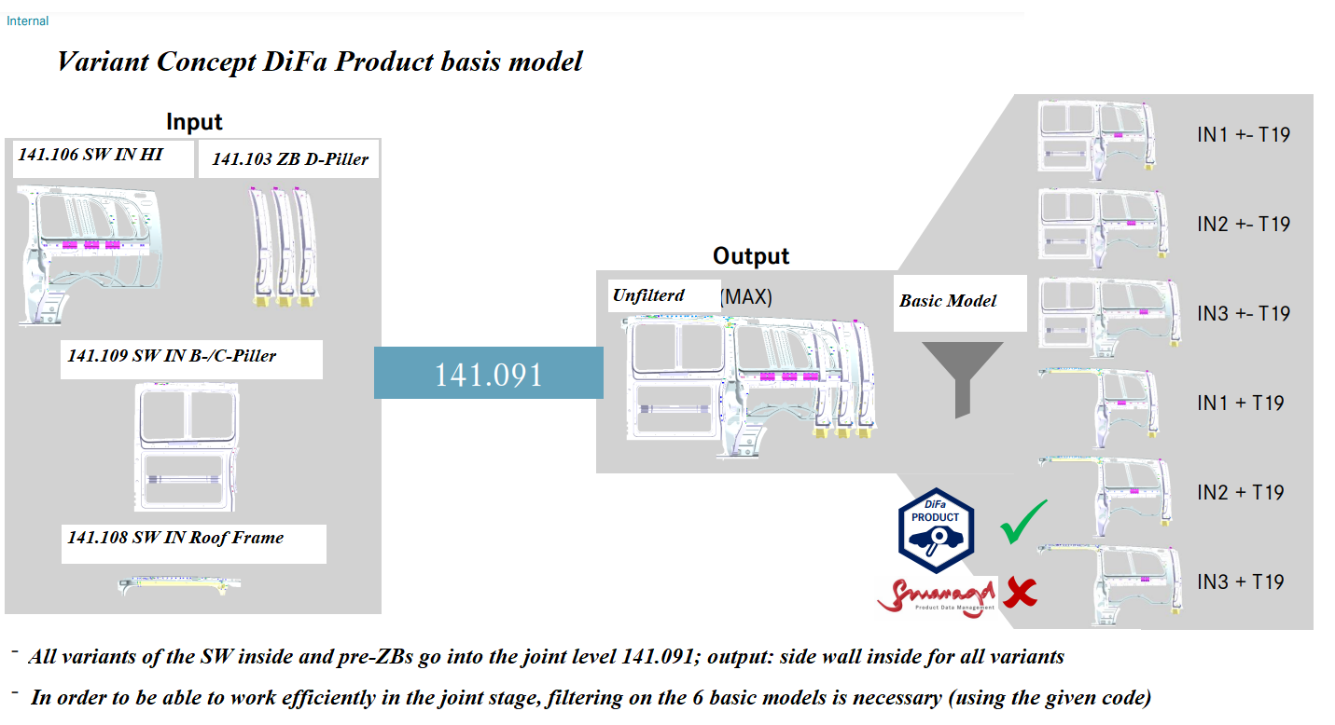

Slide 15
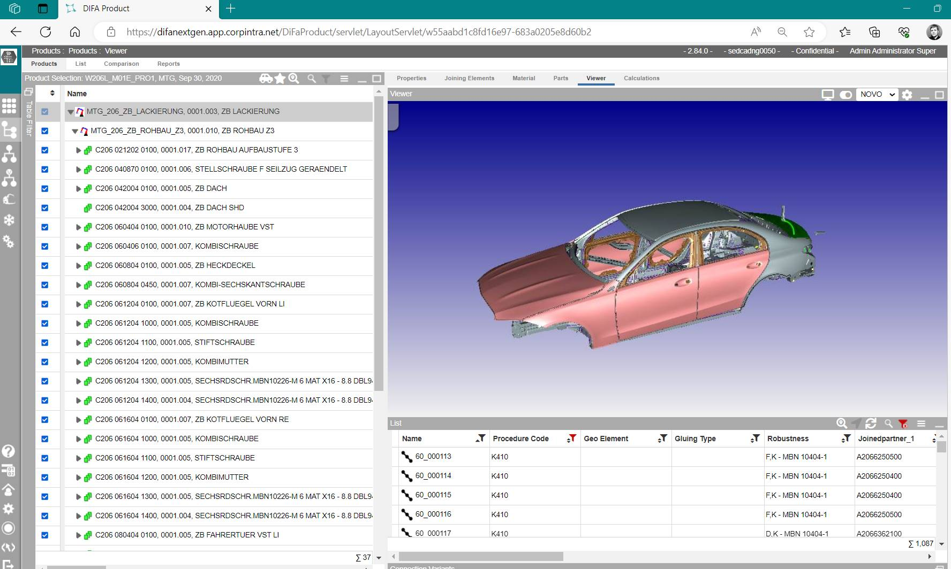
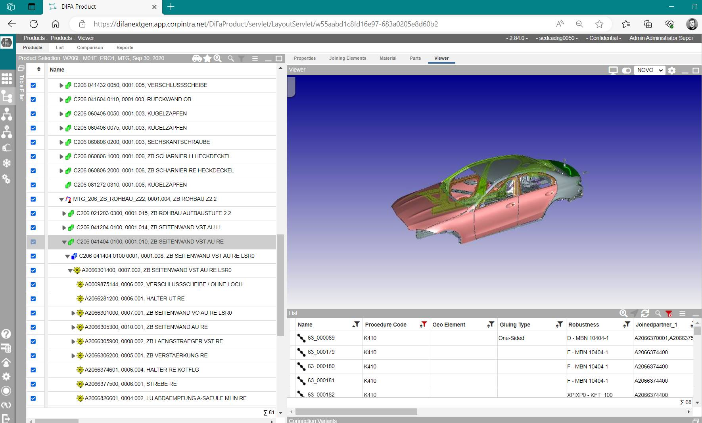
EBOM

Slide 16
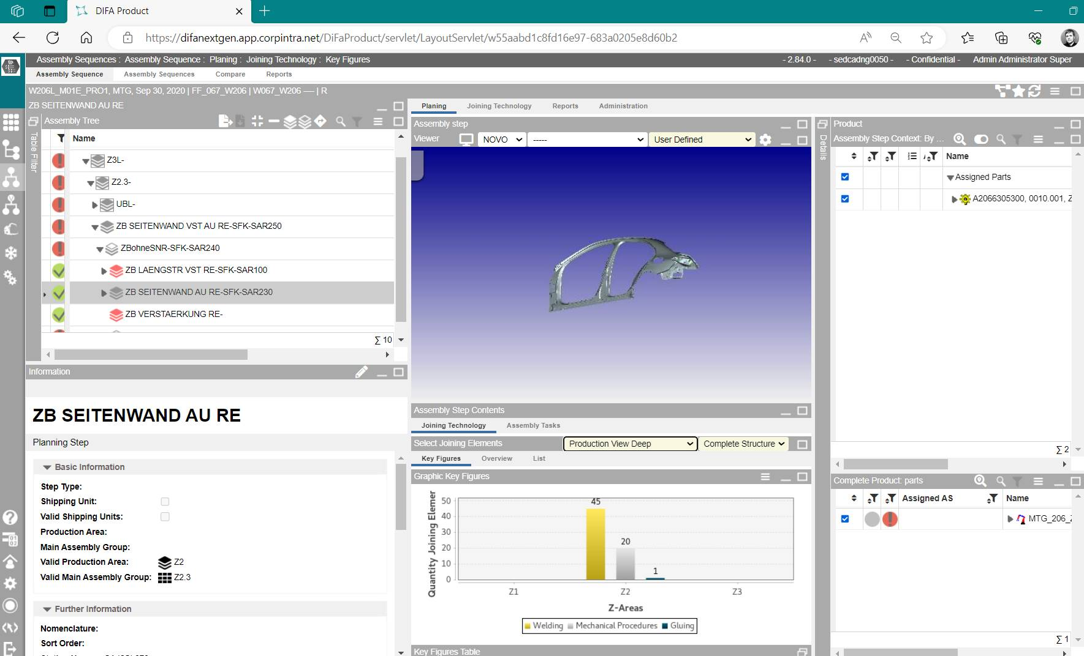
MBOM

Slide 18
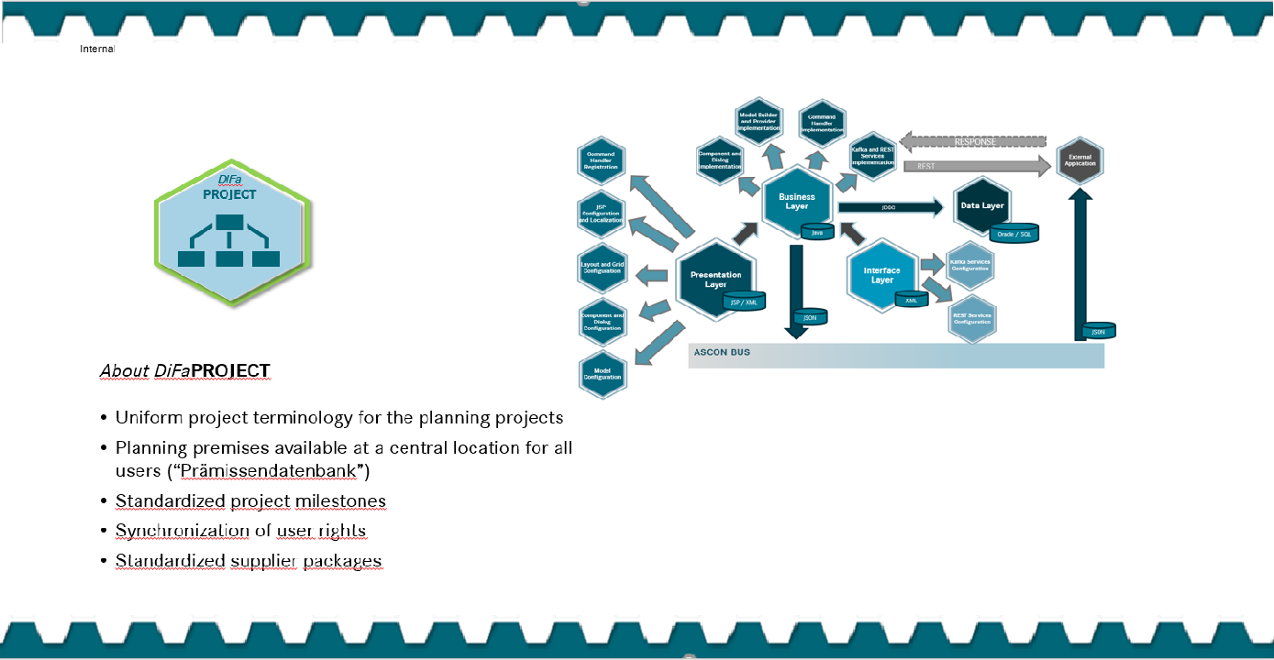

Slide 20
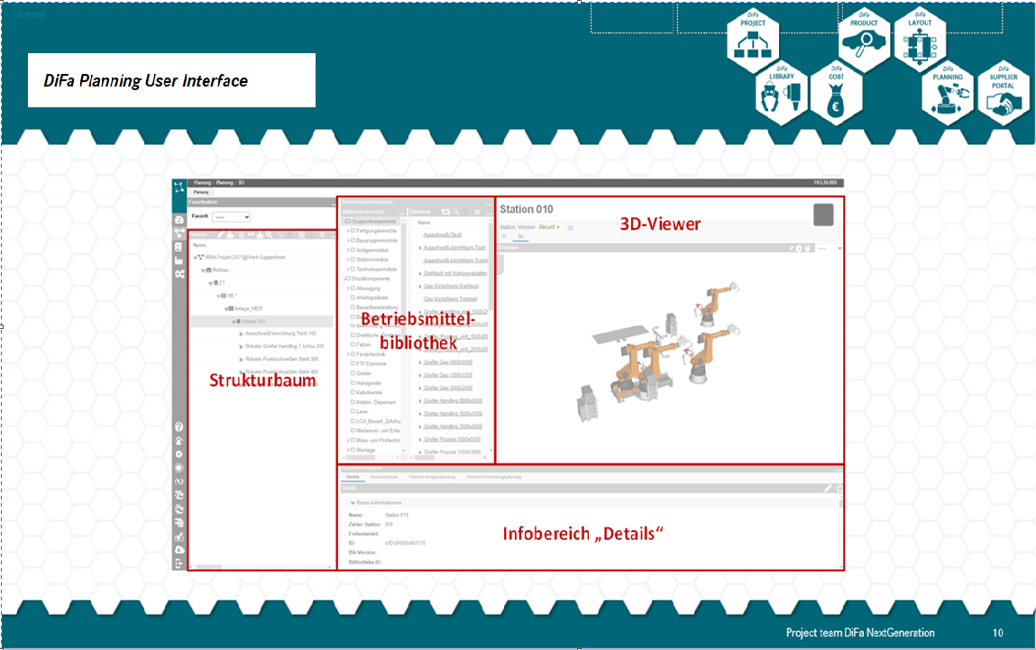

Slide 21
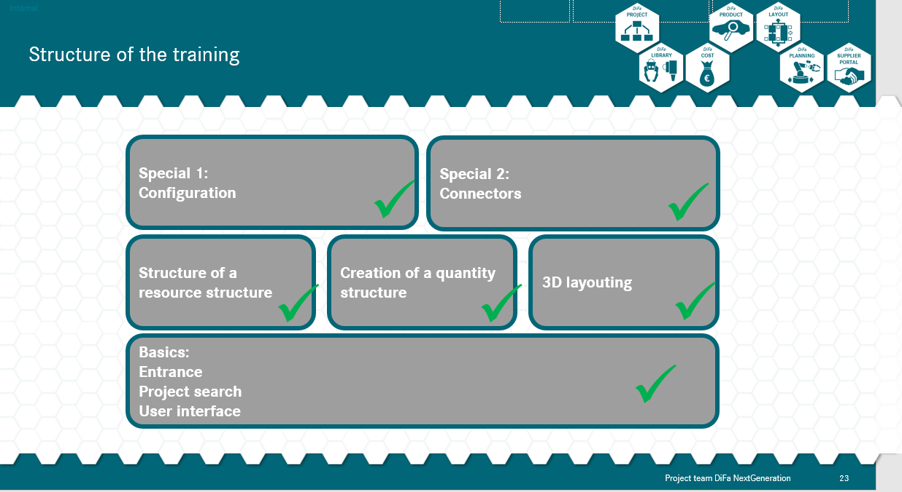

Slide 22
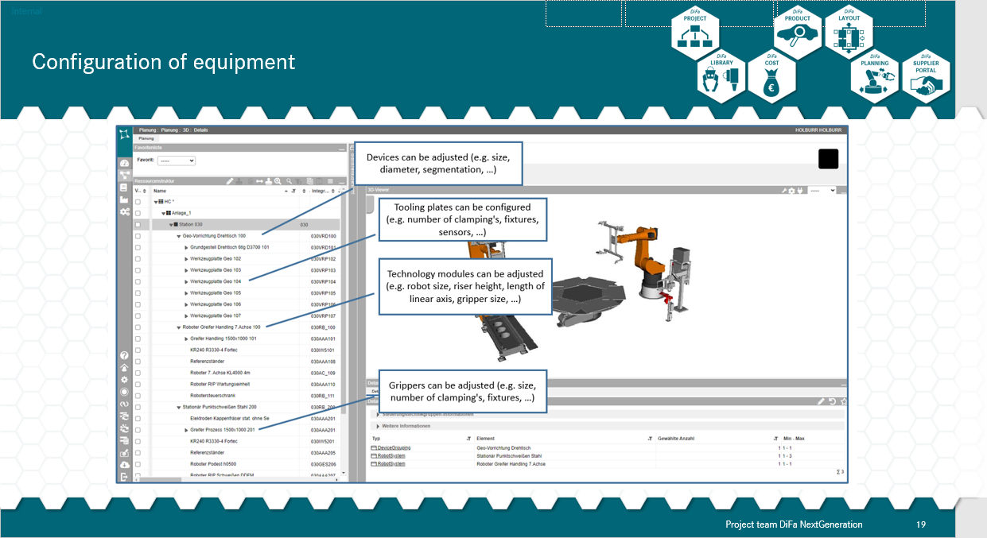

Slide 24
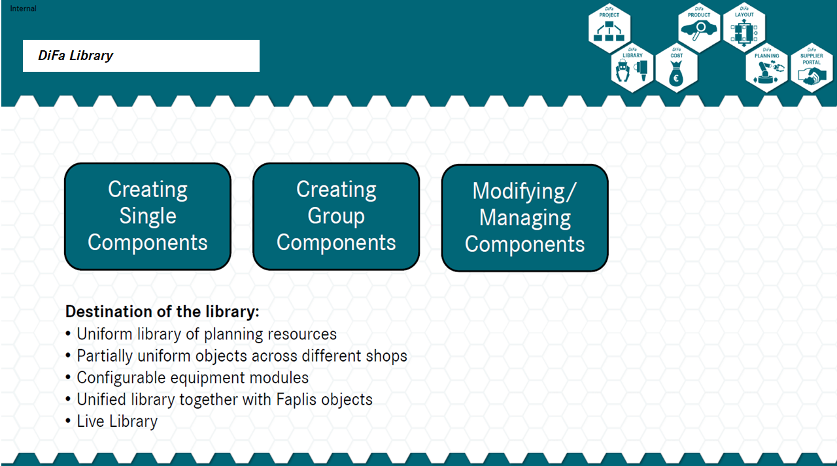

Slide 25
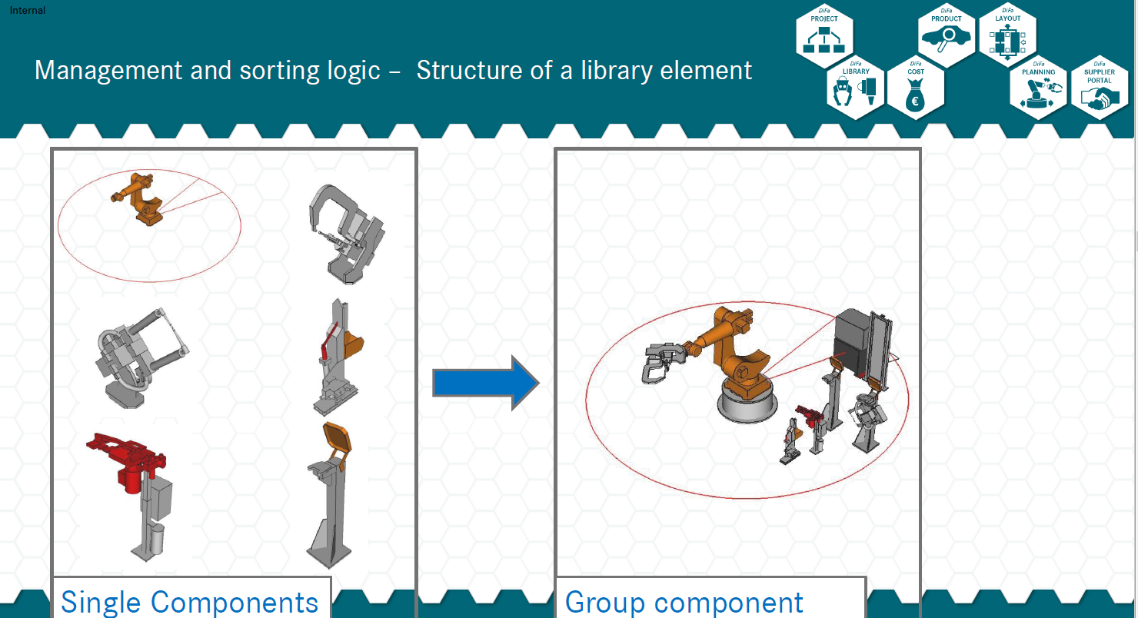

Slide 27
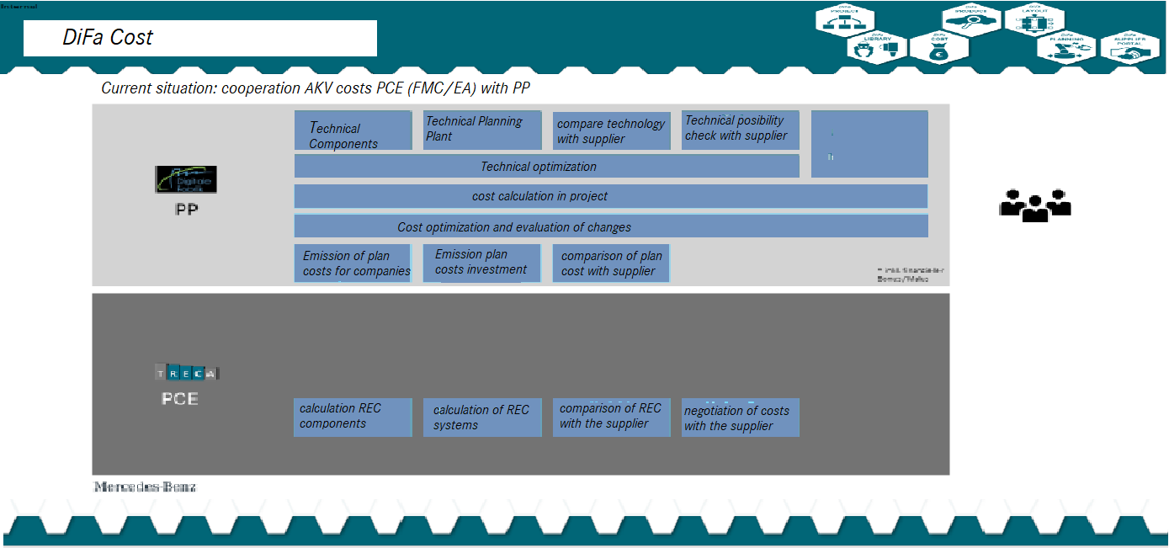

Slide 28
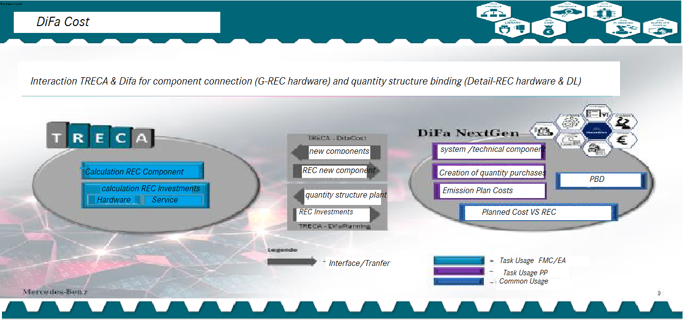

Slide 29
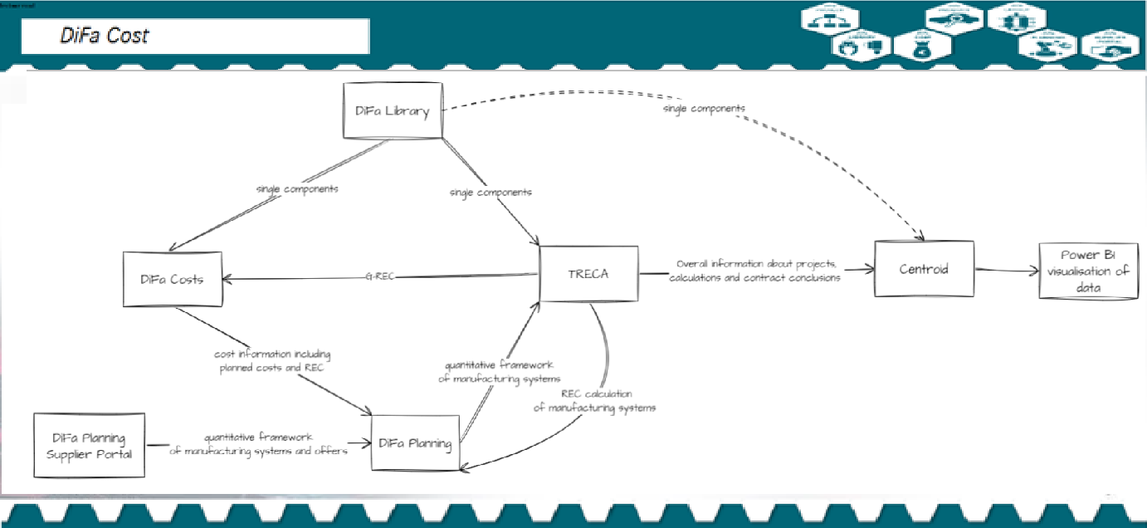

Slide 30







Milestones & Future Roadmap
Create Docker images for the DiFa NG apps
Migration from on premise to cloud
Migration from relation databases to FOSS non SQL databases
Complete migration of planning premises to DiFa Project
Achieve Digital Twin
DiFa Planning apps Implementation
Visualization integration with Netallied
Development & Integration Planning
2013-2016
2017-2018
2019-2021
2023
2022
2012
Successful rollout of the following DiFa NG apps for business use
DiFa Project
DiFa Product
DiFa Planning apps
TRECA
Benchmark
Proof of Concept
Realization with ASCon and Focus on implementation of DiFaProduct and DiFa Project

Slide 31
MDS
SOP
Strategy
Planning
Engineering
Commissioning
Pramissen
Smaragd
ITD / RD
EBOM
ITO / MO
Planning Backbone
Faplis Layout
Difa Product
Difa Planning
Difa Supplier Portal
MBOM
Equipment BOM
S1
S2
S3
Project Structure
Carline
Equipment Library
Difa Project
Difa Cost
Difa Library
Difa NG
DEEP

